Slide 1
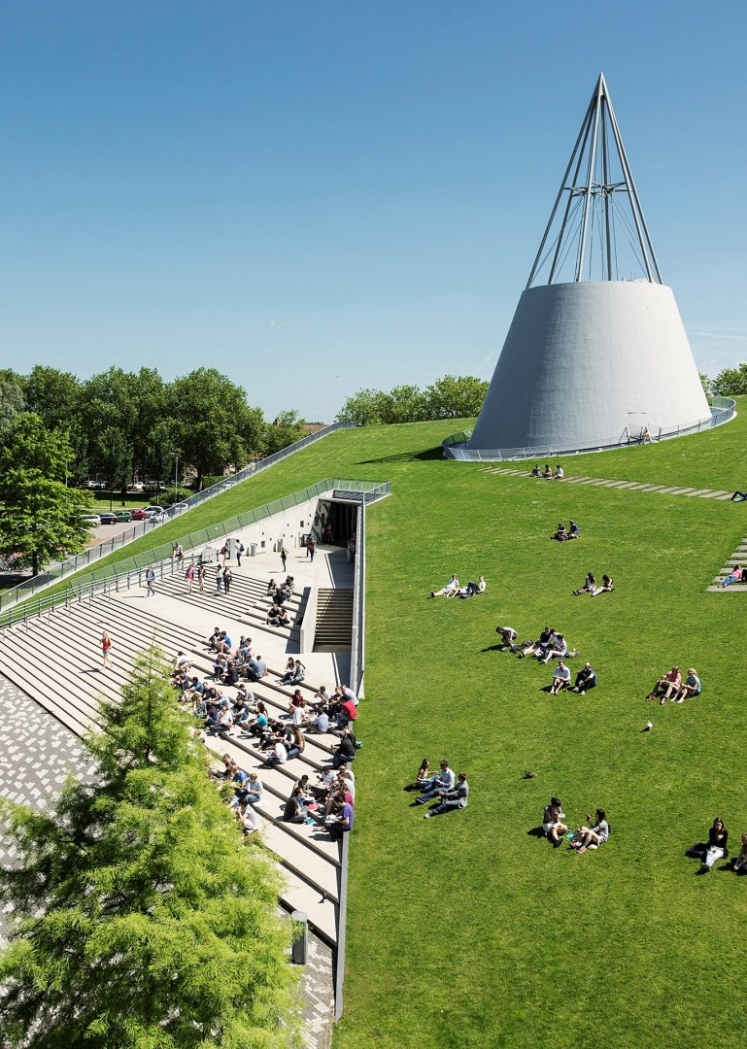
Title slide + image
AE4422-20 Agent based modelling
Conceptual Design

Slide 2
Content
Recap agents
Environment
Concept model
Conflict solving
Agent properties
Functional flow
Concept model extension

Slide 3
Quote
How can an airport utilising taxibots for sustainable taxiing operations, be modeled by a multi-agent
based modelling approach?

Slide 4
Scope/assumptions
We focus on fully automated airport movements (taxiing) so no ATC is present
We focus only on the movement of aircraft and taxiing bots
When the aircraft and taxibot are connected the speed is constant and the steering/stopping is decided by the aircraft
The airport layout is modeled by a directed graph a set of connected taxiways runways and gates
All taxiways can be traversed in both directions
The airport only has one departure and one arrival runway
Departing aircraft only move from gate to the departure runway and arriving aircraft only move from the arrival runway to the gate
Departing aircraft disappear from the model at the departure runway and arriving aircraft appear at the arrival runway

Slide 5
Scope/assumptions
When an aircraft arrives at the arrival runway a taxibot should be ready to pick up
Agents have global awareness of the positions of the other agents
Weather is not considered
Infrastructure is always available
Taxibots aircraft performance availability are always constant and reliable
No other vehicles are considered on the airport
No turn around operations are considered
All gates fit one aircraft

Slide 6
Agents
Aircraft:
Is an agent because it decides, during the taxiing, where to go and when to stop
Taxibots:
Is an agent because it decides, during movements between pick-ups, where to go
Environment is not, because it only provides information and it does not decide anything

Slide 7
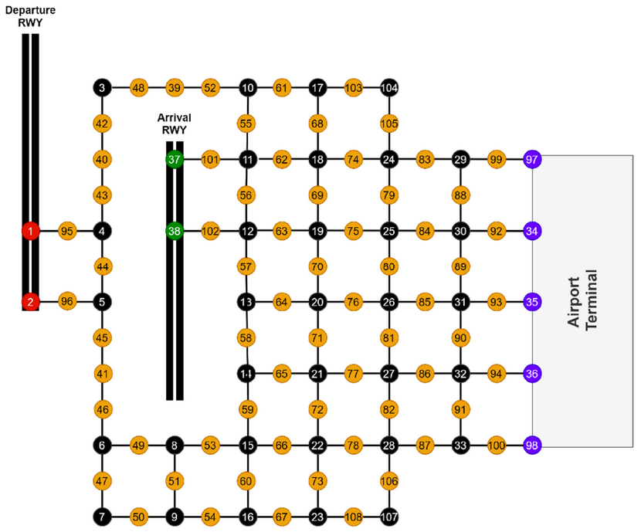
Environment
Two runways, one for departure, one for arrival
Nodes at every intersection of taxiways
5 gates (nodes 97, 34, 35, 36 & 98)
1 arrival runway (nodes 37 & 38) 1 departure runway (nodes 1 & 2)
Runway pick-up nodes (nodes 95, 96, 101 & 102)
Holding nodes for taxibots (nodes 7, 9, 16, 23, 107)
Robustness check by disabling taxiways and/or gates

Slide 8
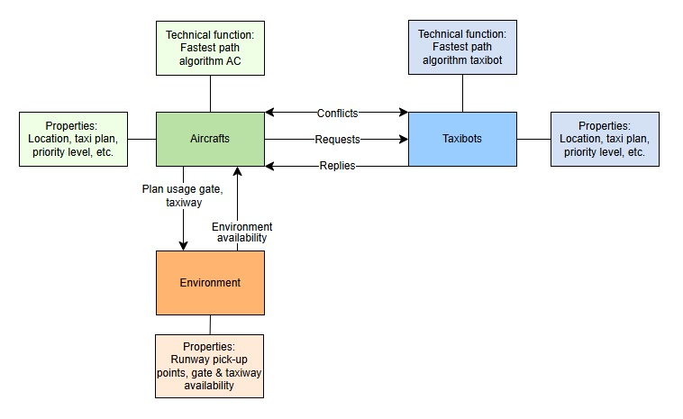
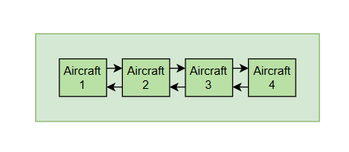
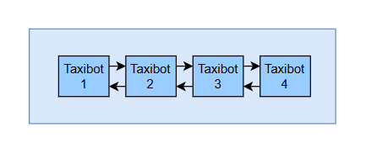
Concept model
Database

Slide 9
Conflict solving
Simple approach with local decision optioins
Limited view
Follow own path untill conflict arises
Conflict is solved by priority level
Examples:
Taxibot with the most delay has priority
Taxibot closest to final destination
Taxi who departed first from the gate has priority
→ Combined into priority level

Slide 10
Agent properties
Aircraft | Taxibots
Location | Location
Current taxi plan | Current taxi plan
Current priority level | Current priority level
Attached or not | Attached or not
Moving or not | Moving or not
Requesting pick-up or not | Available for pick-up or not
Scheduled arrival & departure time

Slide 11
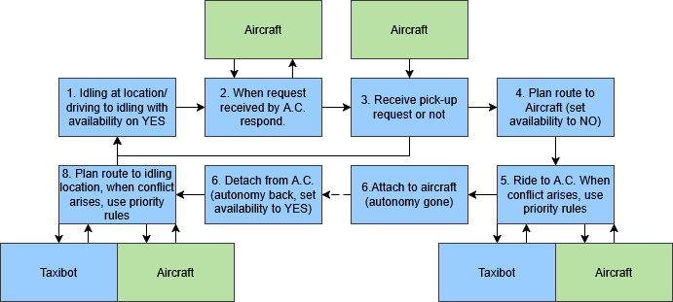
Functional flow (taxibot perspective)

Slide 12
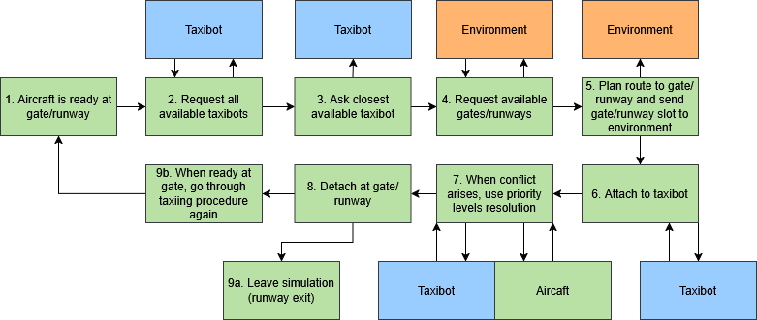
Functional flow (aircraft perspective)

Slide 13
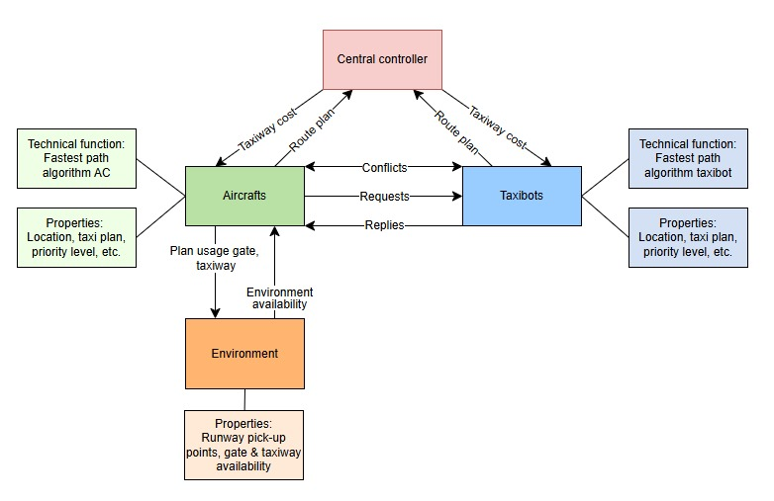
Concept model extension

Slide 14
Environment
Two runways, one for departure, one for arrival
Nodes at every crossing of taxiways
5 gates

Slide 15
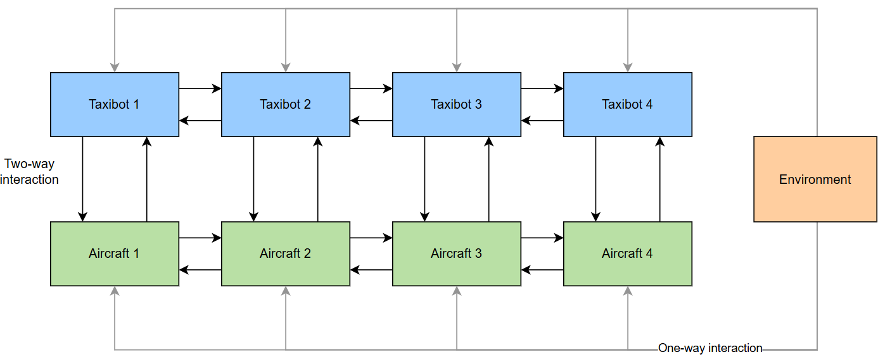
Model overview

